Slide 1
INVESTMENT CASE STUDY
SUBMISSION
Santhosh Kumar

Slide 2
<Abstract>

Slide 3
<Problem solving methodology>
Use flow chart

Slide 4
<Analysis>

Slide 5
<Analysis>

Slide 6
<Analysis>

Slide 7
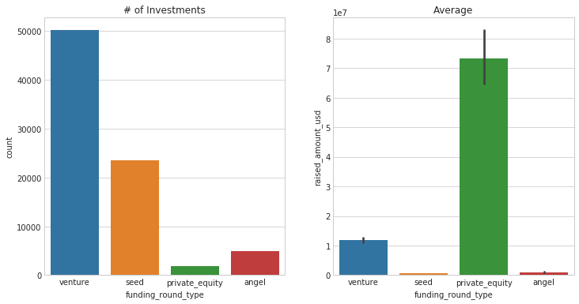
<Results>
Plot 1

Slide 8
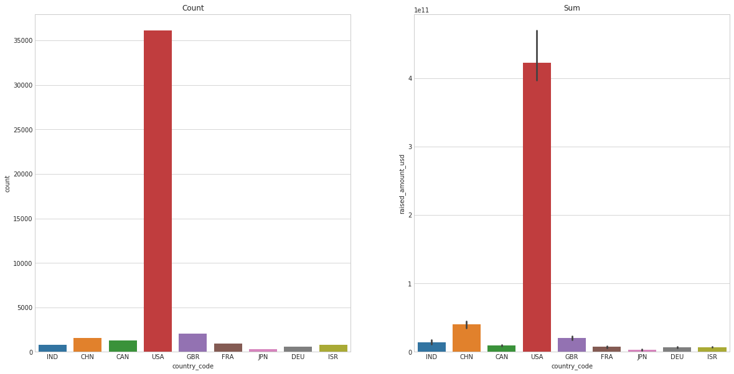
<Results>
Plot 2

Slide 9
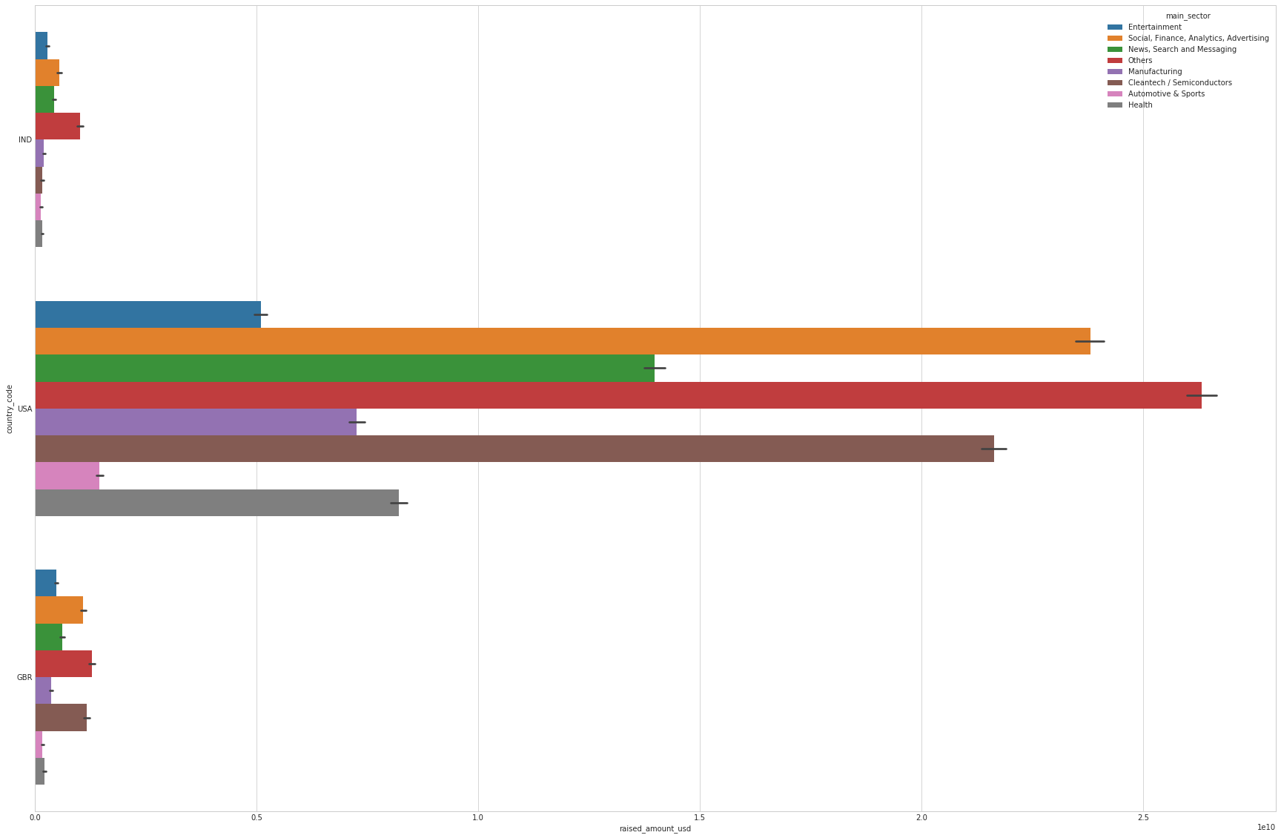
<Results>
Plot 3

Slide 10
<Conclusions>

